Slide 1
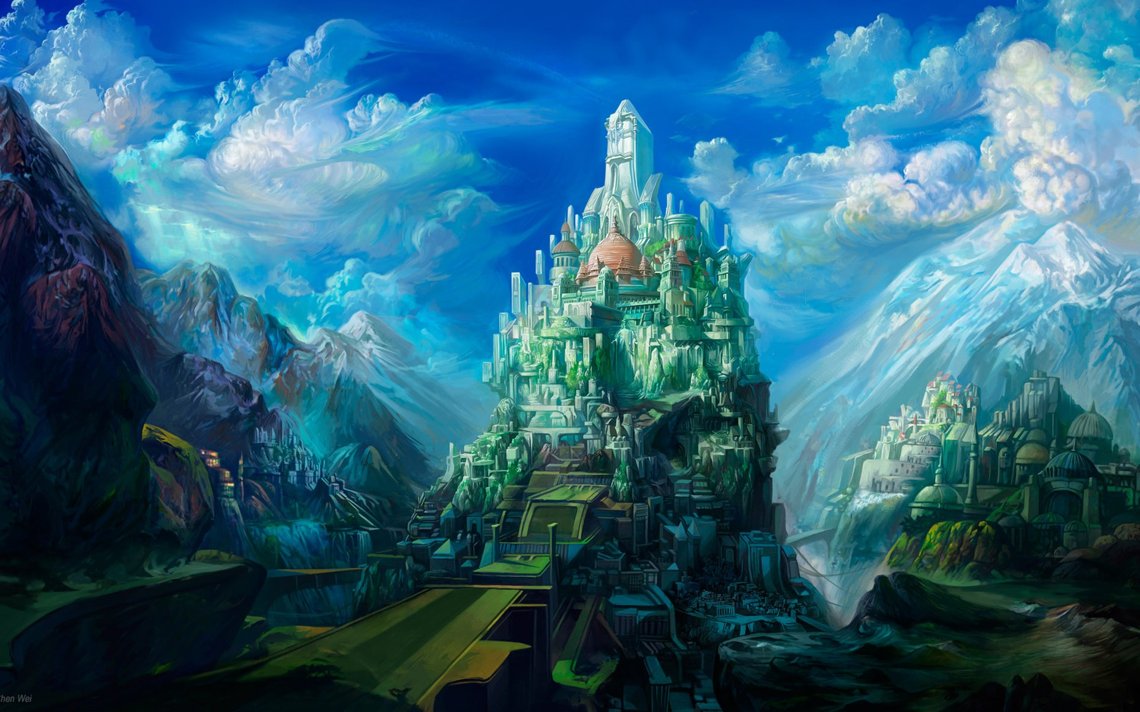
HEAVEN ON EARTH SUNDAY

Slide 2
MORE ABOUT HEAVEN – AND YOU!

Slide 3
Signed, Sealed and (about to be ) Delivered!
Romans 8:14-24

Slide 4
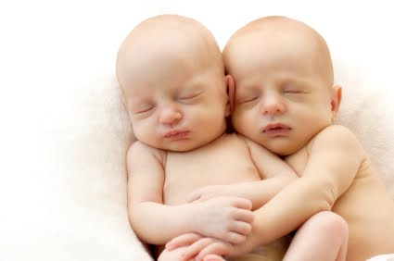
A Parable of Twins in the Womb

Slide 5
GLORIOUS RESTORATION
No More Curse: vv.18-21
Curse Not Lifted Till After the Millennium

Slide 6
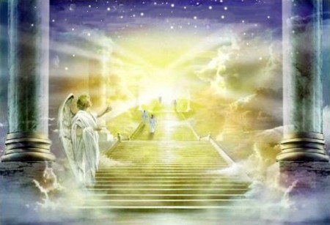
GLORIOUS ADMINISTRATION
God’s Perfect Govt. Will Reign

Slide 7
“For unto us a child is born, unto us a Son is given: and the government shall be upon His shoulder:

Slide 8
“…of the increase of His government and peace there shall be no end,…to order it and to establish it…

Slide 9
“…with judgment and with justice from henceforth even forever…” Isaiah 9:6,7

Slide 10
“…and they shall reign for ever and ever.” Rev. 22:5b

Slide 11
“But the saints of the Most High shall take the Kingdom and possess the Kingdom for ever, even for ever and ever.” Dan. 7:18

Slide 12
GLORIOUS ADMINISTRATION
God’s Perfect Govt. will Reign
He Will Be a Benevolent Dictator

Slide 13
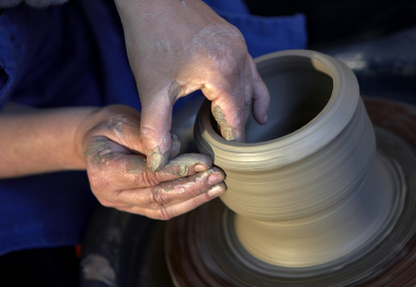
GLORIOUS TRANSFORMATION: vv. 18,19,23
NOW We Groan
THEN We Shall Be Like Him

Slide 14
“…we know that when He shall appear, we shall be like Him; for we shall see Him as He is.” 1 Jn. 3:2b

Slide 15
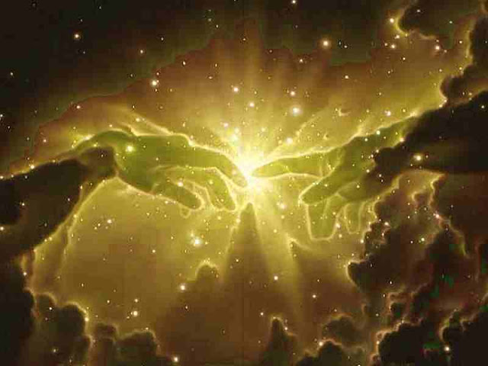
GLORIOUS ILLUMINATION
When Paradise is Restored He Will Again Be The Light

Slide 16
“And there shall be no night there; and they need no candle, neither light of the sun; for the Lord God giveth them light and they shall reign for ever and ever.” Rev. 22:5

Slide 17
“And the city had no need of the sun, neither of the moon to shine in it: for the glory of God did lighten it, and the Lamb is the Light thereof.” Rev. 22:23

Slide 18
“These sayings are faithful and true: and the Lord God of the holy prophets sent His angel to shew unto His servants the things which must shortly be done.” Rev. 22:6

Slide 19
We are “Signed, Sealed and (about to be ) Delivered!”
How are we doing?!

